Slide 1
Atomicity of Distributed Transactions

Slide 2
Atomicity of Distributed Transactions
Distributed systems, transactional consistency is guaranteed by the Atomic Commit Protocol.
It coordinates two phases:
voting and
Decision to ensure that a transaction is either fully committed or completely canceled on several nodes.
To ensure that a transaction is either fully committed or completely canceled on several nodes.

Slide 3
Atomic Commit
The atomic commit procedure should meet the following requirements:
All participants who make a choice reach the same conclusion.
If any participant decides to commit, then all other participants must have voted yes.
If all participants vote yes and no failure occurs, then all participants decide to commit.

Slide 4
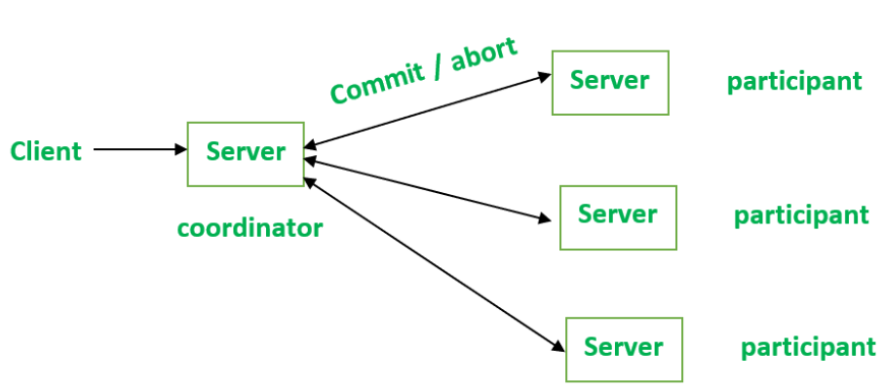
Distributed One-Phase Commit
A one-phase commitment protocol involves a coordinator who communicates with servers and performs each task regularly to inform them to perform or cancel actions i.e. transactions.

Slide 5
Distributed Two-Phase Commit
Phase 1: Voting
A “prepare message” is sent to each participating worker by the coordinator.
The coordinator must wait until a response whether ready or not ready is received from each worker, or a timeout occurs.
Workers must wait until the coordinator sends the “prepare” message.
If a transaction is ready to commit then a “ready” message is sent to the coordinator.
If a transaction is not ready to commit then a “no” message is sent to the coordinator and resulting in aborting of the transaction.
Phase 2: Completion of the voting result
The Coordinator will check about the “ready” message. If each worker sent a “ready” message then only a “commit” message is sent to each worker; otherwise, send an “abort” message to each worker.
Now, wait for acknowledgment until it is received from each worker.

Slide 6
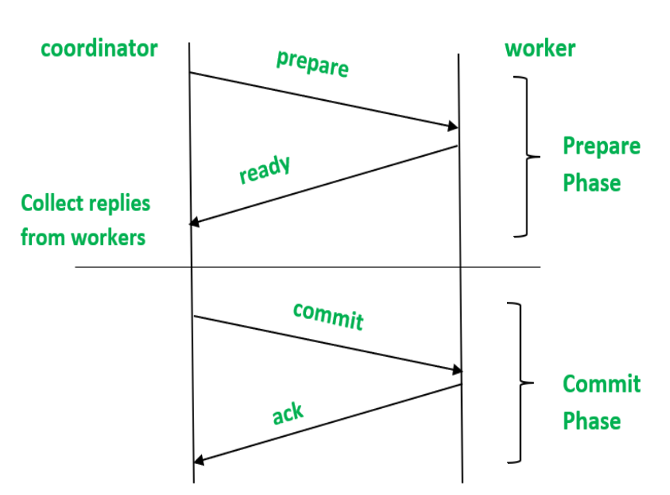
Distributed Two-Phase Commit

